Slide 1

AI to Aid in Police Composites
Kangjian (James) Gao
Raghav Rama Bhadran
Sahithi Sukhavasi
Trishal Jadhav

Slide 2




BIG DATA DINOSAURS
James Gao
Raghav Rama
Sahithi Sukhavasi
Trishal Jadhav

Slide 3
Table of contents
1
Introduction
4
Model
2
Literature review
5
Result
Business and Purpose
Impact and Future Scope
3
6

Slide 4
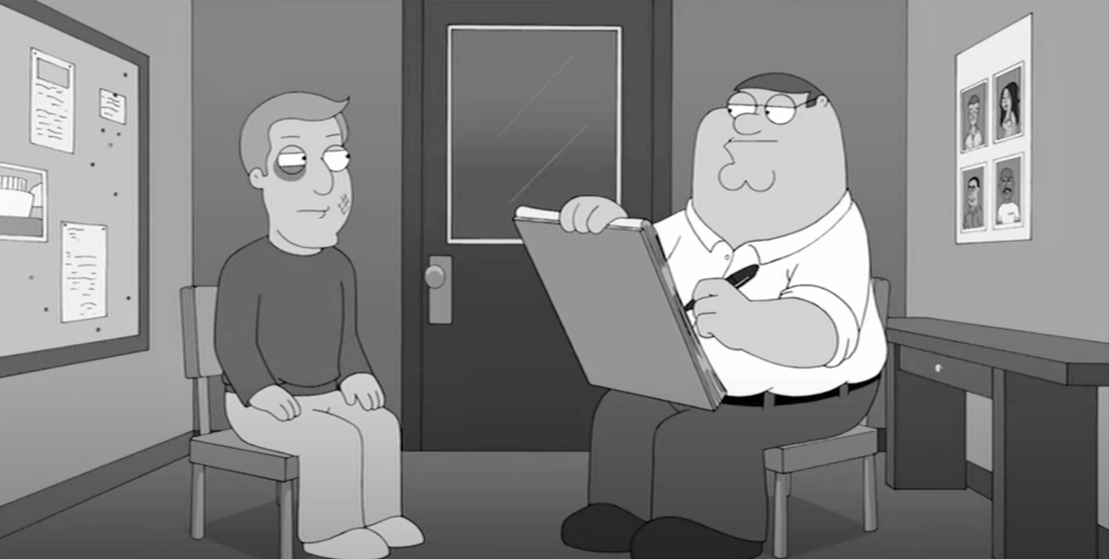
An introduction to Forensic Art
Gathering Information
Engaging with a Forensic Artist
Sketch Development
Presenting the Composite Sketch
Notes:
Process of drawing a police composite sketch:
To create a police composite sketch, the process typically involves the following steps: First, detailed descriptions of the suspect's appearance are gathered from witnesses or victims. Next, a collaboration with a forensic artist specializing in composite sketches takes place. The gathered information is then provided to the forensic artist, who begins creating an initial sketch. Through an iterative process, the sketch is refined based on feedback, with particular attention given to emphasized features and unique characteristics. Once finalized, the composite sketch is reviewed for accuracy. Presentation materials are prepared, incorporating the sketch, and providing necessary context to explain that it is an approximation based on descriptions. Finally, the completed sketch is distributed to aid in identifying the suspect, with the goal of generating leads and assisting in the investigation.
Composite sketches are visual aids and should be used alongside other investigative techniques.

Slide 5
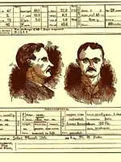
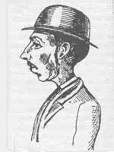
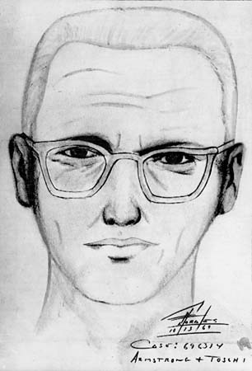
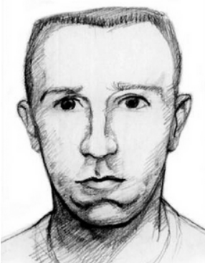
Timeline of Forensic Art
1880
1881
1966
1995
Alphonse Bertillon
First Case
The Zodiac Killer
Timothy McVeigh
Notes:
Alphonse Bertillon:
Developed criminal anthropometry
Measured physical characteristics of prisoners
Led to the capture of numerous repeat offenders.
First Case: 1. Earliest case of a police composite sketch used by Scotland Yard
2. Verbal description led to creation of composite
3. Located within a month based on the sketch
Zodiac Killer:
One of the most famous use cases of Forensic art used in America was the sketch of SF’s very own The Zodiac Killer who went on a spree from 1966 to 1974 believed to have ~37 victims.
He used to send SFPD cryptic messages to which led to him getting his name.
He was never caught.
Timothy McVeigh Sketch
McVeigh was responsible for bombing the federal building in Oklahoma City on April 19, 1995.
After the rear axle of the Ryder truck was located, it yielded a vehicle identification number that was traced to a body shop in Junction City, Kansas.
Employees at the shop helped the FBI quickly put together a composite drawing of the man who had rented the van.
Agents showed the drawing around town, and local hotel employees supplied a name: Tim McVeigh.

Slide 6
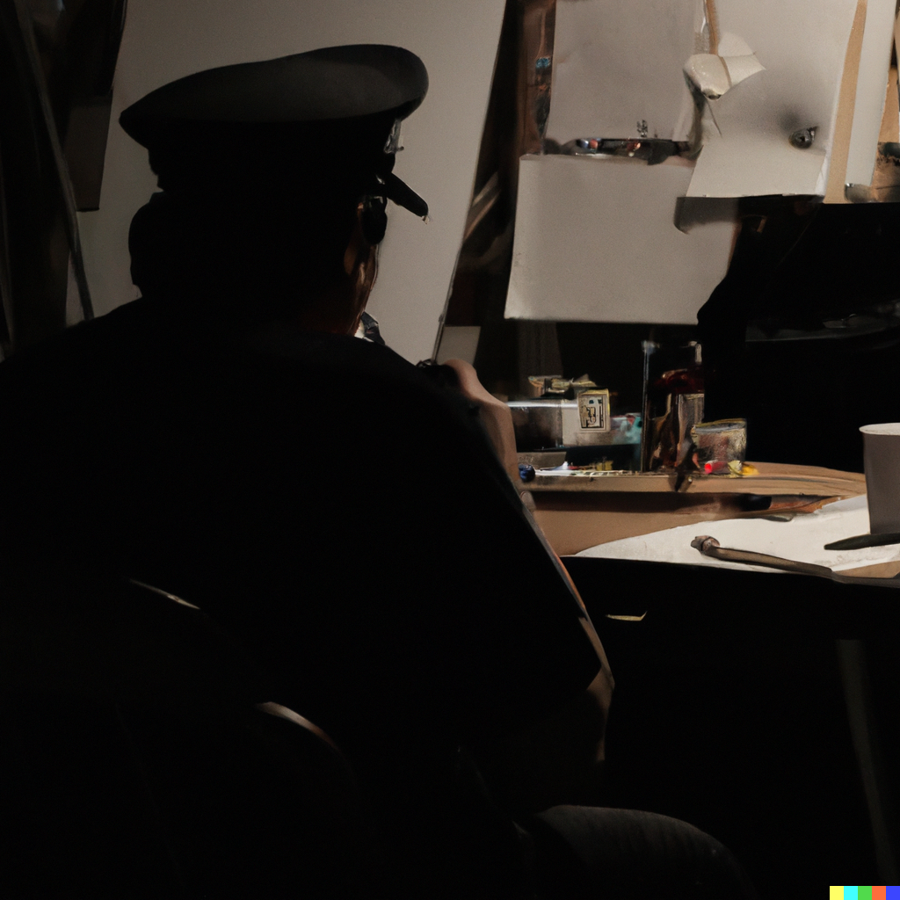
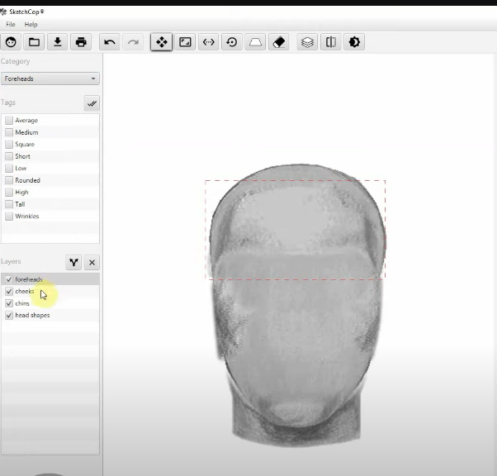
Different Methods
Hand-drawing
Feature Based
Notes:
Hand-drawing
Construction of the composite was originally only performed by a trained artist, through drawing, sketching, or painting, in consultation with a witness or crime victim. The FBI claims that hand-drawing is its preferred method for constructing a facial composite.
Feature-based selection
Feature-based systems essentially rely on the selection of individual features in isolation. Individual facial features (eyes, nose, mouth, eyebrows, etc.) are selected one at a time from a large database and then electronically 'overlaid' to make the composite image. This allows images to be created when suitable artistic talent is not available.
Such systems were originally mechanical, using drawings or photographs printed on transparent acetate sheets that could be superimposed on one another to produce the composite image. The first such system was the drawing-based "Identikit" which was introduced in the U.S. in 1959. A photograph-based system, "Photofit", was introduced in the UK in 1970. Modern systems are software-based; common systems include SketchCop FACETTE Face Design System Software, Identi-Kit 2000, FACES, E-FIT and PortraitPad.

Slide 7
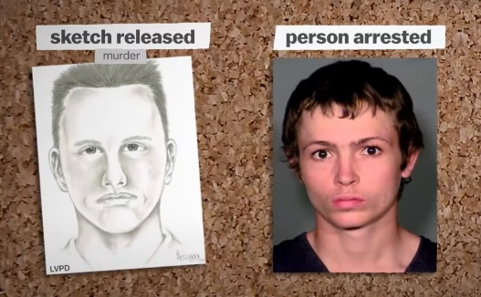
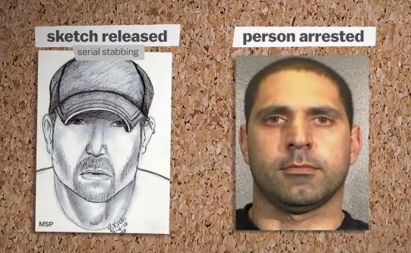
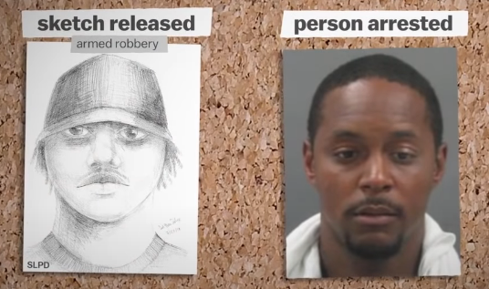
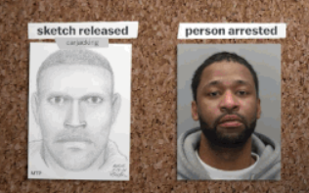
Is it time to retire the police sketch?
Notes:
The accuracy of these sketches and finding better methods to capture memories on paper is explored.
Limited data is available on how often sketches help catch criminals.
In many cases, the likeness of the sketch is not strong.
Notable exceptions include sketches like that of Oklahoma City bomber Timothy McVeigh or suspects with distinctive looks.
Academic experiments show sketches being identified around 8% of the time.
While it is arguably better than nothing, there are risks associated with releasing inaccurate sketches.

Slide 8
Dataset we are working with!
Chicago Face Database developed at the University of Chicago,
Standardized photographs of male and female faces of varying ethnicity between the ages of 17-65
Data include both physical attributes (e.g., face size) as well as subjective ratings by independent judges (e.g., attractiveness)
840 Images
685 Images
Data Processing & Cleaning
131 Features
44 Features
Notes:
For data processing and cleaning, we are removing duplicates, images with not enough data and columns with high null values, we are also doing feature engineering to bucketize and remove some columns which do not provide important information.

Slide 9
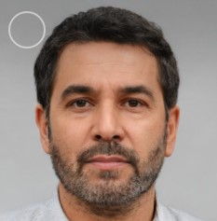

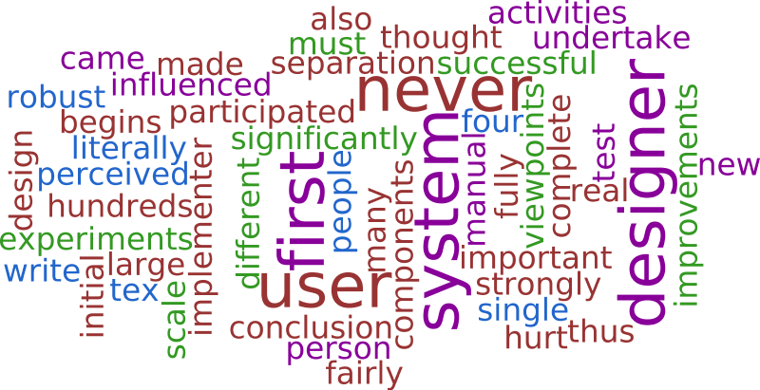
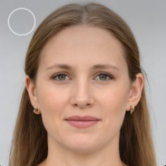
How AI can help with this?

Slide 10
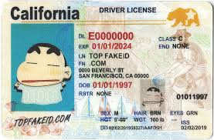
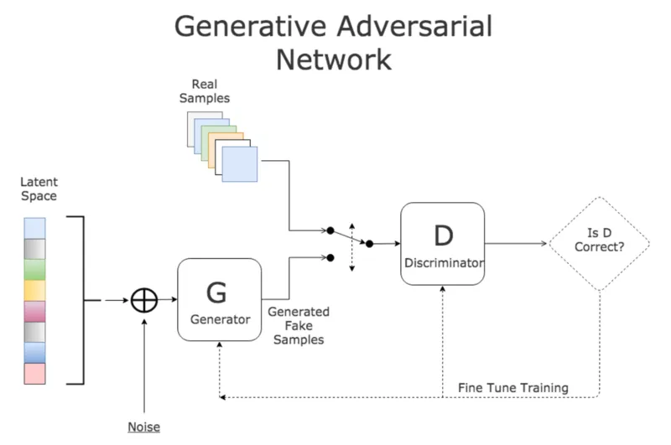
How would that work?

Slide 11
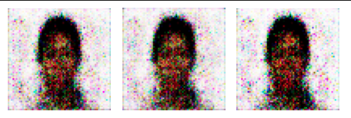
Results
Our GAN model post-training produces images using composite features as input

Slide 12
Impact
Positive psychological impact on eyewitnesses creating a sense of confidence on investigation process.
Enhanced investigative techniques through identification of common features linked to specific crimes.
Reduction of bias that help mitigate human biases in sketching.
NUMBER OF ARRESTS VIA AI COMPOSITES
IMPROVED ACCURACY
TIME EFFICIENCY
USER ADOPTION
COST SAVINGS
Derived Impacts

Slide 13
Future Scope
Training the model on textual descriptions rather than features would allow for the generation of sketches directly from sentences.
Integrate advanced facial recognition capabilities into the application, enabling real-time comparison with databases and improving the speed and accuracy of suspect identification.
Develop future applications of matching the suspects from the initial line up to the composites generated. Supplementing the victims and officials in capturing the right suspects.

Slide 14
Thank You!
Q&A

